Slide 1


RNN, Transformer Architecture and Attention
Dr. Sabyasachi Mukhopadhyay Outreach Teaching Fellow, Dept. of CSE
IIT Kharagpur

Slide 2


Before We Begin: You Used These Models Today
Sequence models are not lab curiosities. They are already in your pocket.
1
Phone keyboard
Type "Happy" and it offers "Birthday". That is next-word prediction on a sequence.
2
Google Translate
Hindi to English, with the word order flipped correctly. Order and context both matter.
3
Voice assistants
"Set an alarm for 6" works even in a noisy kitchen.
Audio is a sequence of frames.
4
ChatGPT / Gemini / Claude
Drafts your email, explains
your code, and sometimes your excuses for a late assignment.
Inside: LSTM (Gboard, 2018)
Inside: LSTM (2016) → Transformer
Inside: LSTM (2015) → Transformer
Inside: Transformer
Today's journey
RNN
LSTM
ELMo
Attention
Transformer
Our story today: how machines went from "remember the last few words" to "read the whole book at once".

Slide 3


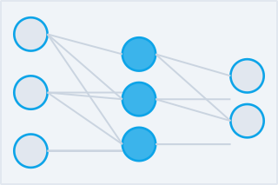





From Perceptron to Specialized Architectures
1958
1980s
1990s
1990s
2017–now
Perceptron
MLP
CNN
RNN / LSTM
x2 x3
h h
Transformer
Σ
conv pool FC
x1
Multi-Head Attention
Head 1
h
Head 2
Head 3
Single neuron Binary output Linear boundary Step activation
Hidden layers Backpropagation Non-linear fn Universal approx
Conv filters Spatial hierarchy Weight sharing Image/vision tasks
Sequential data
Hidden state
Long-term memory NLP / time-series
Self-attention Parallelizable Positional enc. LLMs / GPT / BERT
Deep Learning · IIT Kharagpur
Complexity & Specialization →

Slide 4

Recurrent Neural Networks (RNNs) & LSTMs
RNN Applications
Natural Language Processing
Time Series & Audio
Machine Translation
Sentiment Analysis
Named Entity Recognition
Text Generation / LLMs
Speech Recognition
Music Generation
Stock Price Forecasting
Anomaly Detection in Signals
CNN vs. RNN: At a Glance
Aspect
CNN
RNN
Best For
Spatial / grid data
Sequential / temporal data
Memory
None (feedforward)
Hidden state across timesteps
Key Op.
Convolution + pooling
Recurrent weight updates
Famous
ResNet, EfficientNet
LSTM, GRU, Seq2Seq

Slide 5
Recurrent Neural Networks (RNNs) & LSTMs
What is Sequential Data?
Key Insight
Data where order matters
Each element depends on previous ones
Standard networks treat inputs independently and fail
Traditional feedforward networks assume inputs are independent.
But in "The cat sat on the ", predicting the next word requires remembering ALL previous words.
We need a model with memory.
Text & NLP
Audio & Speech
DNA Sequences
Video Frames

Slide 6

Order Matters: Same Words, Different Story
Shuffle the order and you change, or destroy, the meaning
In language In signals over time
"Dog bites man"
Not news
vs
"Man bites dog"
Front page!
1 ECG: One irregular heartbeat is only "irregular" compared with the beats before it.
"Not bad, actually good"
Positive
vs
"Not good, actually bad"
Negative
2 UPI fraud: ₹50, ₹120, ₹80 ... then ₹49,999 at 3 AM from a new phone. Suspicious only because of the history.
"Mix the batter, then bake"
Cake
"Bake, then mix the
^{vs} batter"
Kitchen disaster
3 Cricket: "6 needed off 1 ball" and "6 needed off 120 balls" are the same numbers, very different heartbeats.
Light moment: A model that ignores order is like reading your WhatsApp family group sorted alphabetically. All the messages are there; the story is gone.

Slide 7
Vanilla RNN (No Gates)
RNN cell h0
RNN cell h1
RNN cell h2
RNN cell h3
x₀
x₁
x₂
x₃
Update rule: hₜ = tanh( Wₕ · hₜ₋₁ + Wₓ · xₜ + b )
No forget gate · No input gate · No cell state, just hₜ carrying memory through time

Slide 8

RNN: Mathematics
Hidden State Update
hₜ = tanh( Wₕ · hₜ₋₁ + Wₓ · xₜ + b )
Output Computation
yₜ = g( Wᵧ · hₜ )
Loss (Cross-Entropy)
L = − Σₜ log P(yₜ | x₁…xₜ)
xₜ = input hₜ = hidden state Wₕ, Wₓ, Wᵧ = learnable weights b = bias

Slide 9





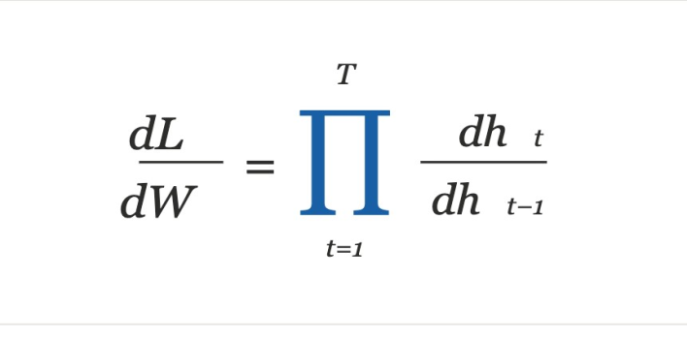


Training RNNs & The Gradient Problem
Step 1: Compute gradients at every time step
At each time step t, backpropagate through the unrolled RNN:
∂Lt / ∂Wh
Backprop Through Time (BPTT)
Unfold RNN across T time steps
Compute gradients at each step
Sum gradients and update weights
Gradient = chain of partial derivatives
Step 2: Accumulate across all time steps
∂L / ∂Wh = Σt ∂Lt / ∂Wh
Sum the gradient contributions from every time step.
Step 3: Update Whh once
Apply a single weight update using the accumulated gradient.
Wh ← Wh − η · ∂L/∂Wh

Slide 10
RNN in Action
t = 1
Example: predicting next word in "The cat sat on the "
t = 2 t = 3
t = 4
xₜ = x₁
input: "The"
xₜ = x₂
input: "cat"
xₜ = x₃
input: "sat"
xₜ = x₄
input: "on"
hₜ = h₁
tanh(Wₕhₜ₋₁ + Wₓxₜ + b)
hₜ = h₂
tanh(Wₕhₜ₋₁ + Wₓxₜ + b)
hₜ = h₃
tanh(Wₕhₜ₋₁ + Wₓxₜ + b)
hₜ = h₄
tanh(Wₕhₜ₋₁ + Wₓxₜ + b)
h₁
h₂
h₃
ŷₜ = g(Wᵧhₜ)
predicts: "cat"
ŷₜ = g(Wᵧhₜ)
predicts: "sat"
ŷₜ = g(Wᵧhₜ)
predicts: "on"
ŷₜ = g(Wᵧhₜ)
predicts: "the"
L1 = −log P(ŷ1)
L2 = −log P(ŷ2)
L3 = −log P(ŷ3)
L4 = −log P(ŷ4)
Hidden Update
hₜ = tanh( Wₕ·hₜ₋₁ + Wₓ·xₜ + b )
Output
yₜ = g( Wᵧ · hₜ )
Total Loss
L = −Σₜ log P(yₜ | x₁…xₜ)
Input xₜ Hidden hₜ
Output ŷₜ
Loss Lₜ
Recurrent hₜ→hₜ₊₁
Deep Learning · IIT Kharagpur
10

Slide 11


RNN Intuition: The Cricket Scoreboard
One running summary, updated aker every ball, with the same rules every time
Where the analogy breaks (and so does the RNN)
RNN idea
Cricket analogy
Input xₜ
Each ball bowled: dot, four, wicket
Ask the scoreboard: "Who bowled the 3rd over?"
It cannot tell you. The summary kept the score but threw away the story.
That is the RNN's memory limit: everything must squeeze into one fixed-size vector hₜ.
Hidden state hₜ
The scoreboard: 87/3 after 12.4 overs
Shared weights W
Same scoring rules for every single ball
Output ŷₜ
The win-probability meter on TV
Update hₜ = f(hₜ₋₁, xₜ)
New score = old score + this ball
Light moment: An RNN is a goldfish with a diary. It writes a beautiful entry every second, but only ever reads the last page.

Slide 12

Training RNNs & The Gradient Problem
Vanishing Gradient
When |dhₜ/dhₜ₋₁| < 1, the product shrinks exponentially. Gradients approach 0, network stops learning long-range dependencies.
Backprop Through Time (BPTT)
Unfold RNN across T time steps
Compute gradients at each step
Sum gradients and update weights
Gradient = chain of partial derivatives
Exploding Gradient
When |dhₜ/dhₜ₋₁| > 1, the product grows exponentially causing NaN weights. Fix: clip gradients at a threshold.
Solution: LSTM (Long Short-Term Memory)

Slide 13

Why Gradients Vanish or Explode: Just Multiply
Backprop through time multiplies one factor per step. Small errors compound.
0.9¹⁰⁰ ≈ 0.00003
Vanishing
Shrink the signal by 10% per step. After 100 steps, step 1 has almost no say in learning.
1.1¹⁰⁰ ≈ 13,781
Exploding
Grow by 10% per step. After 100 steps the update is enormous and weights turn into NaN.
Real life: Like a WhatsApp forward: "drink water daily" becomes, 50 forwards later, "Antarctic water cures everything".
Real life: Like a microphone held near its speaker: a tiny sound feeds back into a deafening screech.
How practitioners fix it
Gradient clipping
A speed governor on a school bus: drive, but never above the limit
Gated cells
LSTM / GRU learn what to keep, so the product stays near 1
Truncated BPTT
Backprop only k = 20 to 50 steps, not the whole history
Good initialisation
Start weights so the per-step factor is close to 1

Slide 14
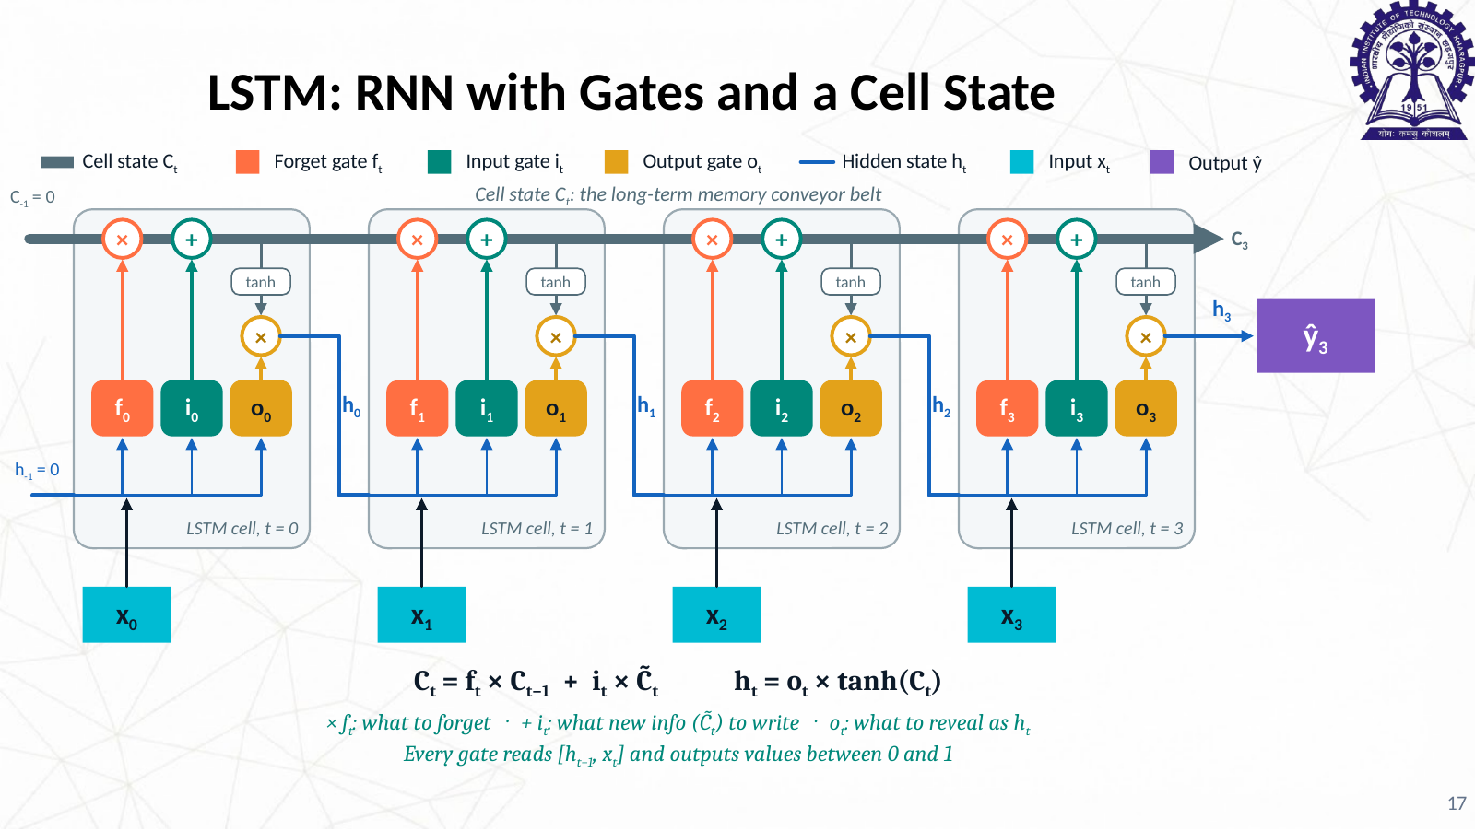

Slide 15

LSTM in Real Life: The Topper's Notebook
Three gates decide what to erase, what to write, and what to say
Cell state Cₜ = the notebook you carry all semester. It travels forward almost untouched, like a conveyor belt.
Forget gate
What should I erase?
Input gate
What is worth writing?
Output gate
What should I say now?
fₜ
iₜ
oₜ
Mid-sems are over. Drop the formulas that will never be asked again.
Use the highlighter only when the professor says "this will come in the exam".
In the viva, answer only the question asked, not the entire notebook.
Where LSTMs still earn their salary today
Next-day electricity load forecasting · vibration sensors for predictive maintenance in factories · on-device keyboards · ECG and wearable streams on low-power chips (small, fast, no giant GPU needed)

Slide 16


Problem 1: The Information Bottleneck
Everything must compress into one fixed-size vector
100 input tokens
w1 w2 w3 w4 w5 w6 w7
(100 tokens total, only first 9 shown)
Fixed cell state dimension
c₁₀₀ is exactly the same size as c₁. A sequence of 1000 tokens gets no more space than a sequence of 10. The longer the input, the greater the compression.
w8 w9 …
▼ compress all into one vector ▼
Early tokens get overwritten
c₁₀₀
ONE fixed vector
Each new token competes for the same fixed vector space. Even if f_t ≈ 1
˜
(forget gate open), new writes via i_t ⊙ C̃_t still push out older content.
Transformer solution: don't compress
Transformers keep all token representations in memory. At each step, attention directly retrieves whichever tokens are needed. No bottleneck.
(w₁, …, w₁₀₀) → c₁₀₀ Even perfect gradient flow cannot recover lost information

Slide 17
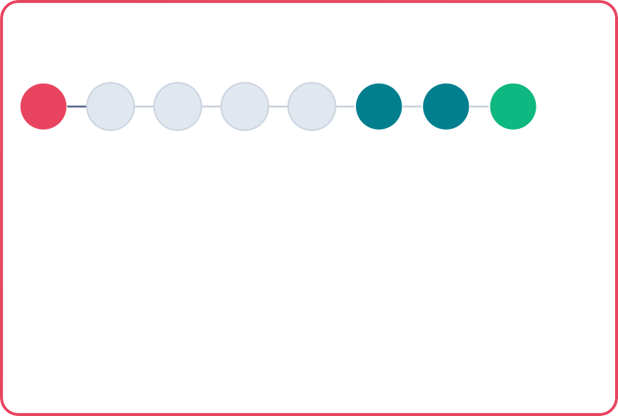
Problem 2: No Direct Access (The Jump Problem)
Token 10 needs token 3, but must travel through every step in between
LSTM: sequential chain (path length = 7 hops):
t=3 t=4 t=5 t=6
⚠irrelevant tokens: signal from t=3 must pass through here
t=7
t=8
t=9
t=10
LSTM
Transformer
3
4
5
6
7
8
9
10
3
1 hop
10
8
1 hop
3→4→5→6→7→8→9→10
Path length: 7
Token 3's signal must pass through 6 irrelevant intermediate states. Information dilutes with each hop.
9
1 hop
3 ─────────► 10
Path length: 1
Direct attention to any token regardless of distance. No intermediate states required.
Path length argument: LSTM solves gradient flow but not selective access. Transformers solve both by attending directly.

Slide 18
ELMo & BiLSTM
Contextual embeddings: same word, different vectors

Slide 19
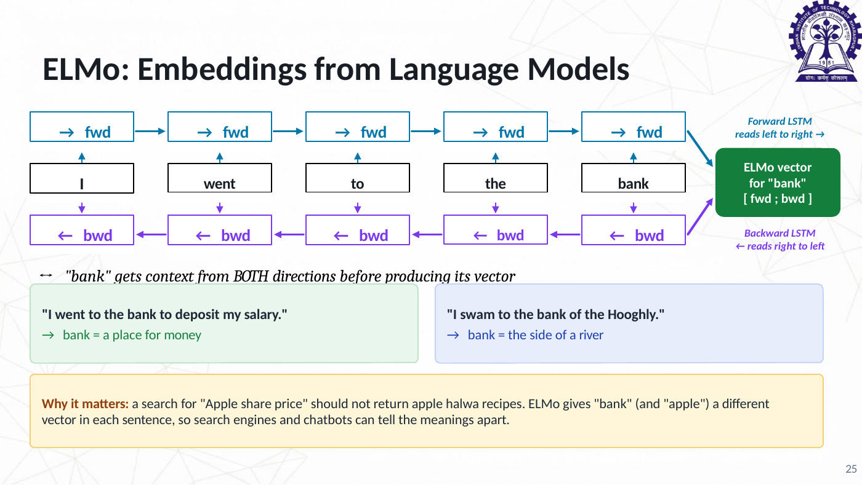

Slide 20
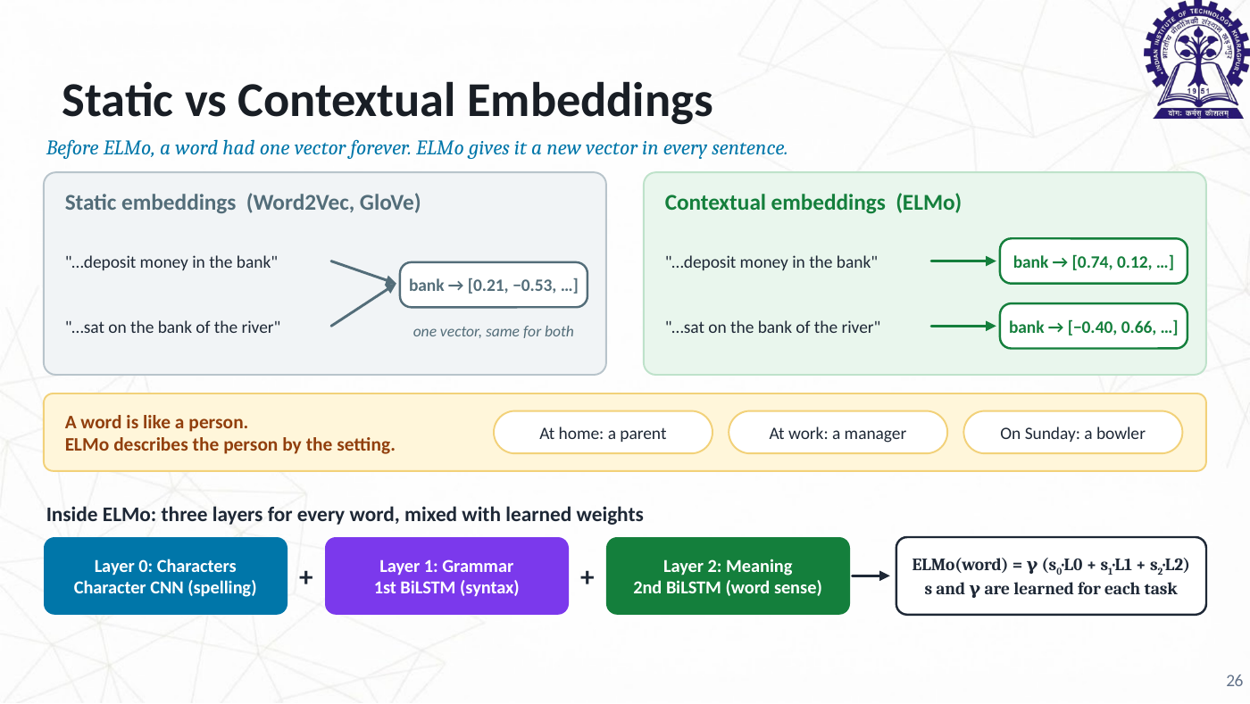

Slide 21
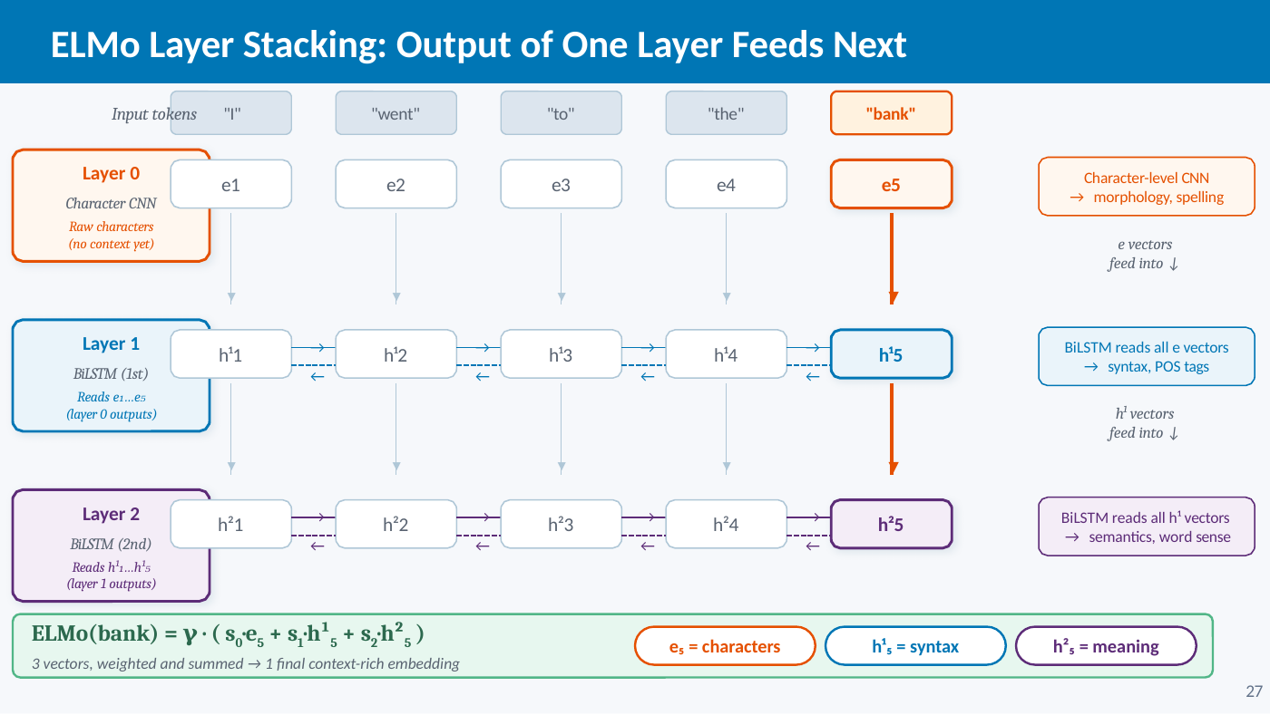

Slide 22
Word2Vec vs ELMo: Key Differences
 | Word2Vec |  | ELMo
Embedding type | Static: one fixed vector per word | context-free | Dynamic: new vector per sentence | contextual
Architecture | Shallow lookup table |  | 2-layer Bidirectional LSTM
Handles polysemy | "bank" always same vector | no | "bank" differs by context | yes
Context used | Training-time context only |  | Both directions at inference | fwd + bwd
Vector layers | 1 layer, single vector |  | 3 layers: char + LSTM1 + LSTM2 | richer
Pre-computation | Pre-compute once, cache all | fast | Re-run full BiLSTM per sentence | slower
Parallelizable | yes |  | no (sequential LSTM)
Similarity check | similarity(bank money, bank river) = 1.0 |  | similarity(bank money, bank river) ≈ 0.54
Word2Vec
"bank" → [0.2, 0.8, 0.1, ...]
same vector in every sentence
ELMo
"bank" (money) → [0.2, 0.8, 0.1, ...]
"bank" (river) → [0.7, 0.1, 0.9, ...]
ELMo's contextual embeddings were a major leap, but its sequential BiLSTM bottleneck motivated Transformers (BERT), which achieve full bidirectionality in parallel.
28

Slide 23

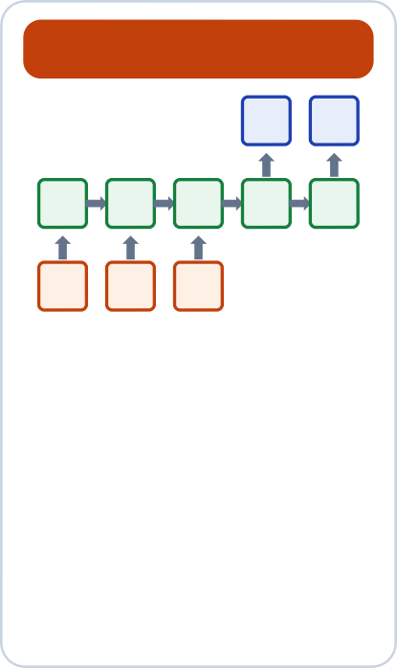



What Can RNNs and LSTMs Do? Four Input-Output Patterns
Count the inputs and the outputs, and you know the type of task
One-to-one One-to-many Many-to-one Many-to-many
1 input → 1 output
Image → "cat" or "dog"
Loan form → approve / reject
No sequence at all: a plain feed-forward net or CNN does this. Our baseline.
1 input → a sequence
Image captioning: one photo
* "A boy playing cricket on the beach"
Music generation: one seed note → a full melody
a sequence → 1 output
Sentiment: a Flipkart review
* positive / negative
Spam filter: an SMS → spam or not
ECG stream → normal / arrhythmia
a sequence → a sequence
Machine translation: Hindi sentence → English sentence (lengths can differ)
•
•
Word tagging: one label per word (names, places, dates)
Shown: the encoder-decoder (Seq2Seq) version, coming up next.
Input
Hidden state (RNN cell)
Output
Light moment: Many-to-one is your mother reading your whole day's "last seen" and returning one output: "Online till 2 AM?"
29

Slide 24
Limitations of Pre-Attention Models
Key issues that motivated the development of Attention Mechanisms
01 | 02 | 03 | 04 | 05
Fixed-Length Context Bottleneck | Vanishing & Exploding Gradients | Poor Long-Range Dependencies | No Parallelism in Training | Uniform Treatment of Input
Encoder-decoder models compressed entire sequences into one fixed-size vector, causing severe information loss for long inputs. | RNNs suffered from gradients shrinking to zero or growing uncontrollably during backpropagation, blocking long-range learning. | Information from early tokens had to pass through many steps, getting diluted before reaching later positions in the sequence. | RNNs process tokens sequentially (each step depends on the previous), making them slow to train and difficult to scale. | All input tokens were weighted equally when generating output, with no mechanism to selectively focus on what matters most.

Slide 25

Attention: You Already Do This Every Day
Focus on what matters for the current step, and quietly ignore the rest
1 The wedding-hall effect
2 The open-book exam
3 The human translator
Loud DJ, 300 guests, yet you instantly catch someone saying your name. Your brain re-weights every sound by relevance.
You do not re-read the entire textbook for every question. You jump straight to the relevant page. That jump is attention.
"Mujhe kal Kolkata jaana hai" → "I have to go to Kolkata tomorrow". While writing "tomorrow", the translator looks back at "kal", not at the last word.
The key idea: instead of one frozen summary, compute a fresh, weighted look at ALL inputs at every output step.
Light moment: Attention is what every teacher wants from students in an online class. Neural networks were the first students to actually learn it.

Slide 26
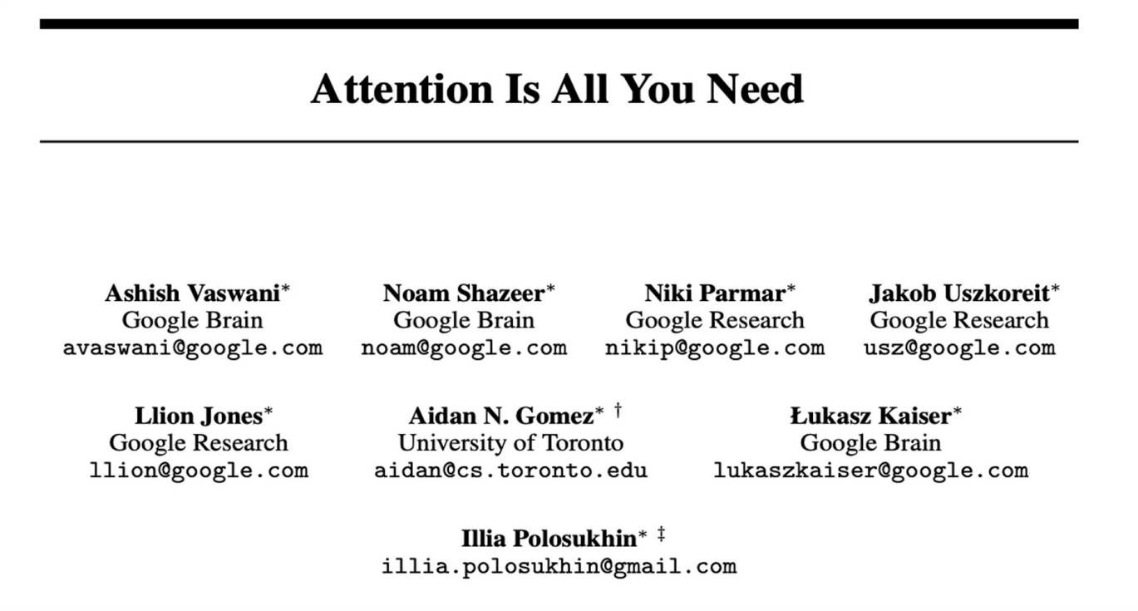
Attention Based Model: Transformer
https://www.youtube.com/watch?v=LWMzyfvuehA

Slide 27
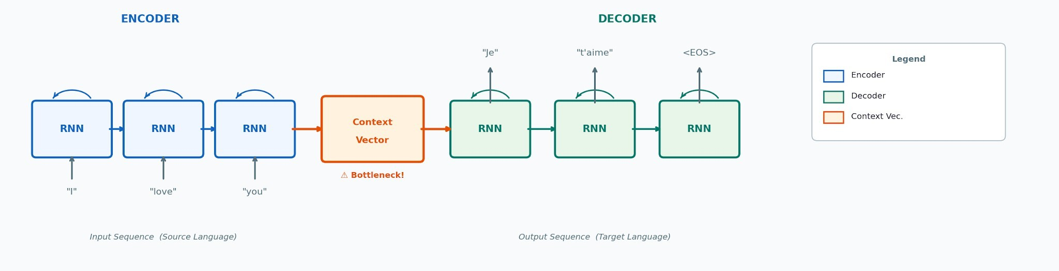
Seq2Seq Model with RNN
Worked example: machine translation, English → French ("I love you" → "Je t'aime")
① Encoder reads "I" → "love" → "you", one word at a time, updating its memory after each word.
② After "you", the final hidden state is the Context Vector: the whole English sentence in one vector.
③ Decoder writes "Je", feeds it back in, writes "t'aime", then
<EOS> to stop. 3 words in, 2 words out.
⚠ Key flaw: a 50-word legal paragraph must squeeze into the same single vector as "I love you".
Indian example: "I am going to Kolkata tomorrow" → "Main kal Kolkata ja raha hoon". The verb jumps to the end, so the decoder needs the meaning of the whole sentence before writing a single word.

Slide 28
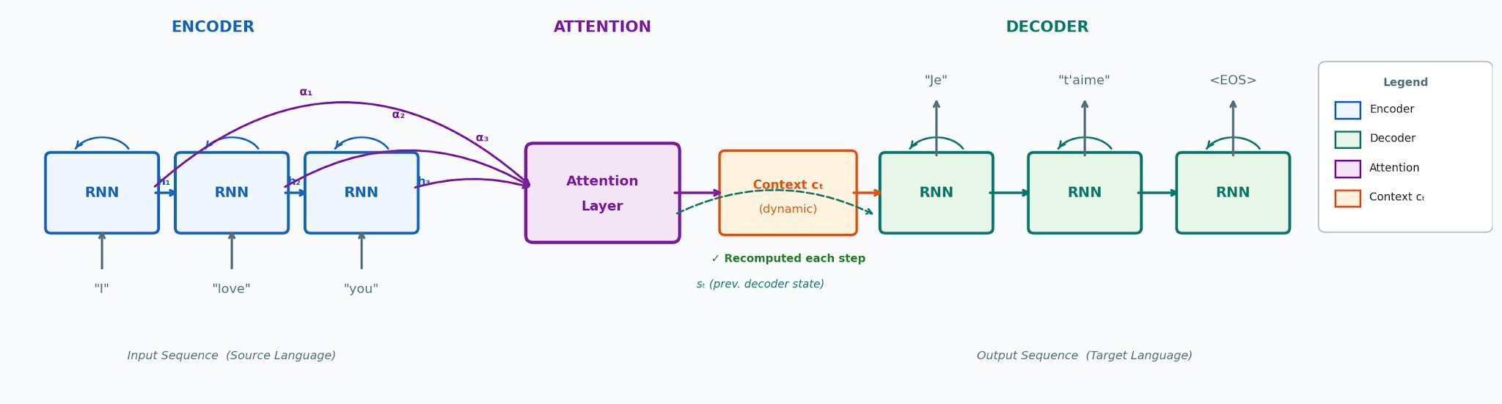
Seq2Seq with Attention Layer
How the Attention mechanism transforms the Encoder–Decoder architecture
① All hidden states retained Instead of a single final vector, all encoder hidden states h₁…hₙ are passed forward. |  | ② Dynamic context per step Attention computes a weighted sum (αᵢ) of encoder states for each decoder step. |  | ③ Context cₜ recomputed A fresh context vector cₜ is computed at every decoder timestep, focusing on what's relevant. |  | Bottleneck eliminated Long-range dependencies are captured directly, no information is lost through a single vector.

Slide 29

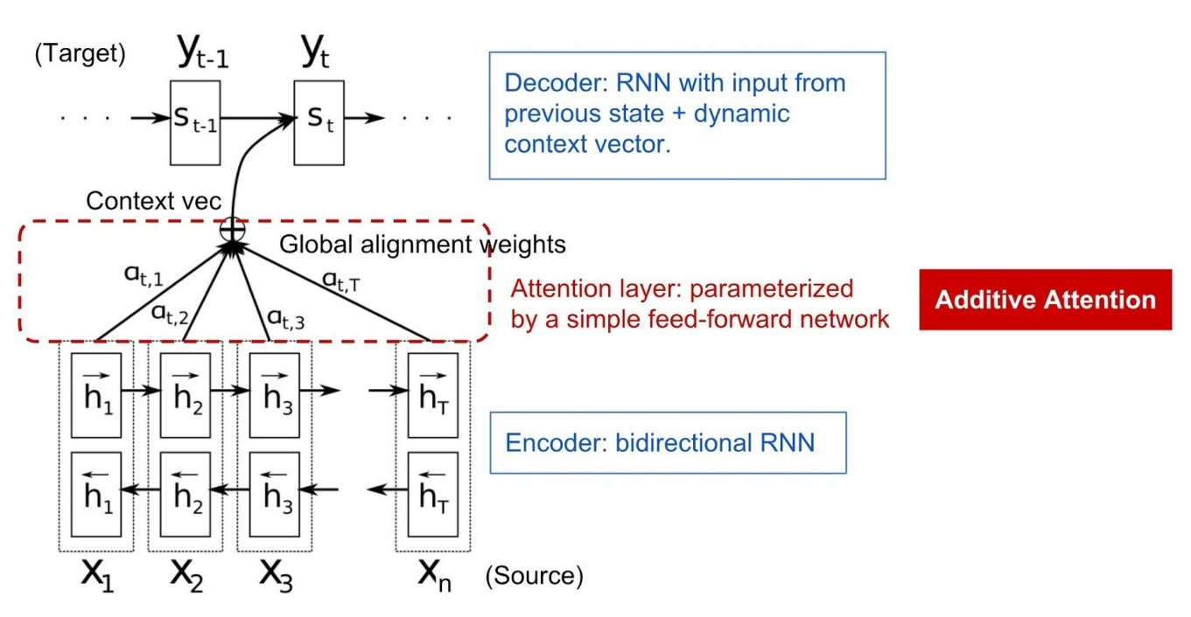

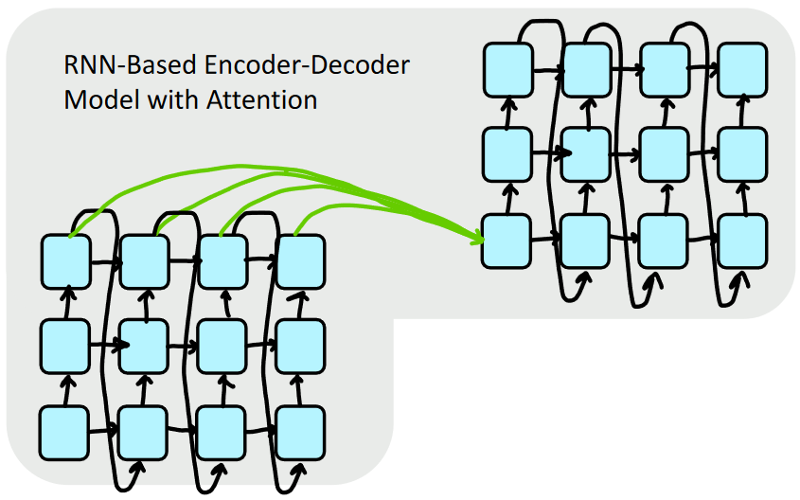
The Attention Idea
Attention treats each word’s representation as a query to access and incorporate information from a set of values.
Bahdanau et al., 2015. Stanford NLP Course: CS224N

Slide 30
Why Attention Alone Wasn't Enough
Remaining limitations that led to Self-Attention and the Transformer architecture
Limitations of RNN + Attention
Transformer Solutions
01 Still Sequential (RNN) The RNN encoder/decoder processed tokens one at a time, no parallelisation across a sequence. |  | 02 One-Directional Attention Attention only ran decoder→encoder. Tokens within the encoder couldn't attend to each other.
⚡ Full Parallelism |  | * Self-Attention
RNNs removed entirely, |  | Every token attends to
all tokens processed |  | every other token in the
simultaneously. |  | same sequence, bidirectionally.
➜
led to
03 Weak Long-Range in Encoder Encoder states were still shaped by sequential RNN steps, early tokens got diluted before being attended to.
04 O(n) Information Path
Information still traveled through n recurrent steps to connect two distant tokens.
◎ O(1) Dependency Path
Any two tokens connect directly in one attention step, regardless of distance.
✦ Multi-Head Attention
Multiple heads capture different relationship types in parallel.
05 No Intra-Sequence Attention
Tokens couldn't ask 'what in this same sequence is relevant to me?', the key idea of self-attention.
06 No Positional Structure
No built-in sense of position, any order had to be implicitly learned through the RNN.
⊕ Positional Encodings
Explicit position signals added to embeddings, order without recurrence.
Attention is All You Need
Vaswani et al. 2017: one unified architecture for encode, decode, and cross-attend.

Slide 31

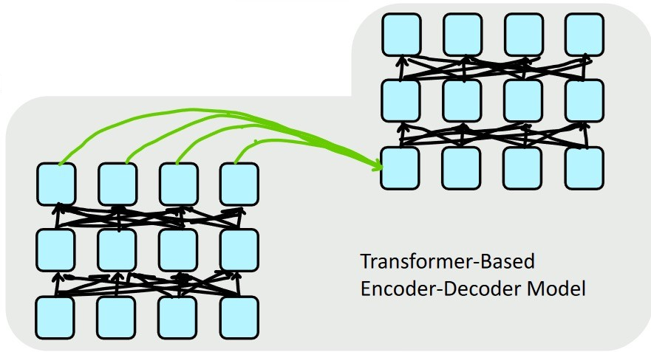

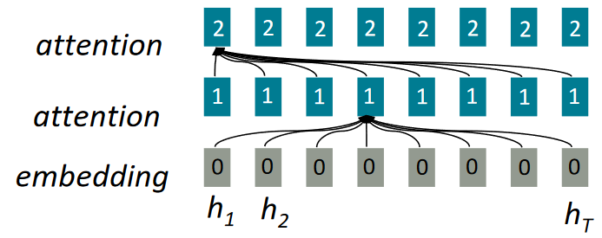
The Self Attention Idea
Self-attention is encoder-encoder (or decoder-decoder) attention where each word attends to each other word within the input (or output).
Stanford NLP Course: CS224N
40

Slide 32
Attention vs self-attention
 | Attention (Bahdanau) |  | Self-attention (Transformer)
Who attends to whom? | Decoder → Encoder cross-sequence |  | Each word → every other word in same sequence within-sequence
Used in | Seq2Seq translation (RNN-based) |  | Transformers: BERT, GPT, T5
Replaces | Fixed context vector bottleneck |  | Sequential LSTM entirely
Key formula | cₜ = Σ αᵢ · hᵢ αᵢ = softmax(FF(s_{t-1}, | hᵢ)) | Attention(Q,K,V) = softmax(QKᵀ/√d) · V
Attention asks "which source words matter for this output word?" Self-attention asks "which words in this sentence matter for understanding each word?"

Slide 33
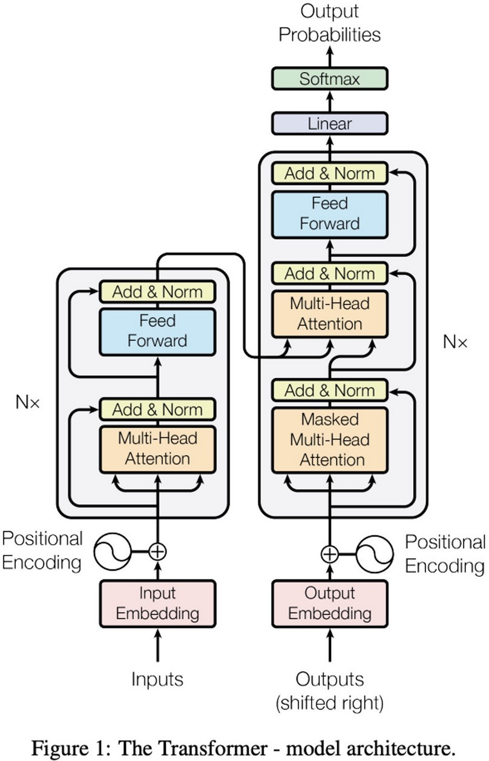
Attention Based Model: Transformer

Slide 34

What is Self-Attention?
Each element looks at all others and decides how much to focus on each.
"The animal didn't cross the street because it was too tired."
👉 What does "it" refer to?
1 ^{Compare}
Compare it with every other word
2 ^{Weight}
Assign higher weight to animal
3 ^{Understand}
Use weights to build contextual meaning
Key Property
Every token can directly interact with every other token, no sequential propagation needed (unlike RNNs).
Long-range dependencies Parallel computation
Dynamic context understanding

Slide 35


Query, Key, Value: Step by Step
"The animal didn't cross the street because it was too tired."
Query Key
Value
Q K
V
What I am looking for
What I represent
What information I carry
* "it" asks: which noun do I refer to?
* animal says: I'm a noun
* actual content to share
Attention scores for "it":
Output for "it":
Output it = 0.83 × Vanimal +
0.11 × Vtired + …
"it" becomes: "something like animal,
with context of being tired"
Word | Key meaning | Score | Weight
animal | noun, living thing | 5.0 | 0.83
tired | adjective | 3.0 | 0.11
street | noun, location | 1.0 | 0.02
others | ... | ≈ 0 | ~0.04 total

Slide 36
Query, Key, Value: The Search Engine Analogy
You use Q, K, V every time you search on an app
Scenario
Query: what I want
Key: what each item advertises
Value: what I actually get
YouTube | "how to cook biryani" | Video titles, tags, thumbnails | The video you finally watch
Job portal (LinkedIn / Naukri) | "Python, 3+ years, NLP" | Resume headlines and skill lists | The full candidate profile
Swiggy / Zomato | "spicy, under ₹300, near me" | Restaurant tags, price, distance | The menu you order from
One crucial difference: a search engine hands you the top hit. Attention returns a soft blend of ALL values, weighted by how well each key matches the query (softmax of Q·K).
Analogy: Ask five friends for a restaurant tip. You trust the foodie friend 70%, the hostel friend 20%, and the gym friend 5%. That weighted opinion is the attention output.

Slide 37
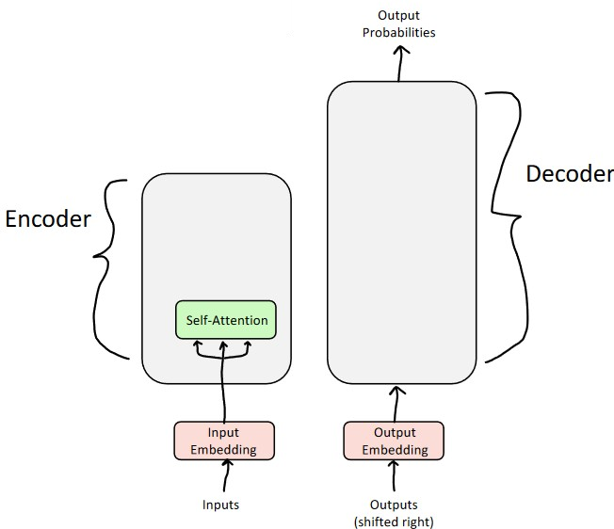
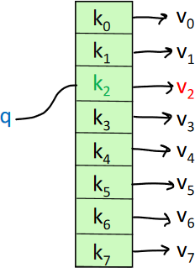
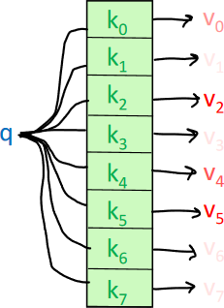
The (Self) Attention Mechanism
o
Attention as a "fuzzy" or approximate hashtable
To look up a value, we compare a query against keys in a table
In a hashtable (shown on the bottom left):
º Each query (hash) maps to exactly one key-value pair
o
In (self-)attention (shown on the bottom right)
Each query matches each key to varying degrees.
We return a sum of values weighted by the query-key match.

Slide 38
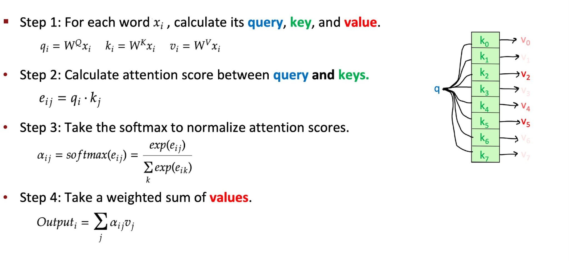
Recipe for Self-Attention in the Transformer Encoder
^{x}(i +1) ^{= o}i

Slide 39
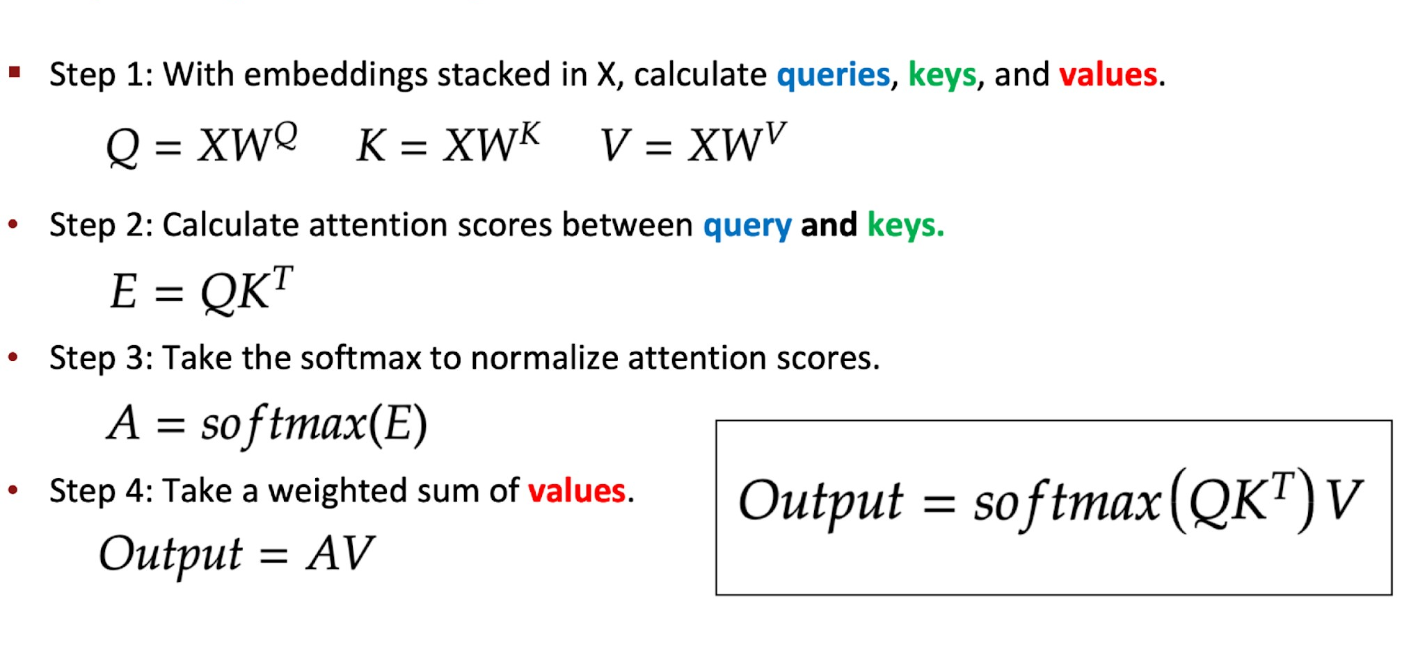
Recipe for (Vectorized) Self-Attention in the Transformer Encoder

Slide 40


Tiny Self-Attention: Step by Step
2 tokens: x₁ = "animal", x₂ = "it" · embedding dim d = 2
Input X
WV (weights)
[ | 1 | 1 | ]
[ | 1 | 0 | ]
Output = A · V
"animal"
0.73·[1,1] + 0.27·[1,0]
= [1.0, 0.73]
"it"
0.27·[1,1] + 0.73·[1,0]
= [1.0, 0.27]
"it" has non-zero 2nd component → influenced by "animal" (which carries meaning [1,1])
[ 1 0 ]
[ 0 1 ]
V = X × WV
Q = K = X (WQ=WK=I)
[ 1 1 ]
[ 1 0 ]
Scores = QKᵀ
[ | 1 | 0 | ]
[ | 0 | 1 | ]
*
Attention A = softmax(Scores)
[ 0.73
[ 0.27
0.27 ]
0.73 ]
softmax([1,0]) = [0.73, 0.27]
softmax([0,1]) = [0.27, 0.73]

Slide 41
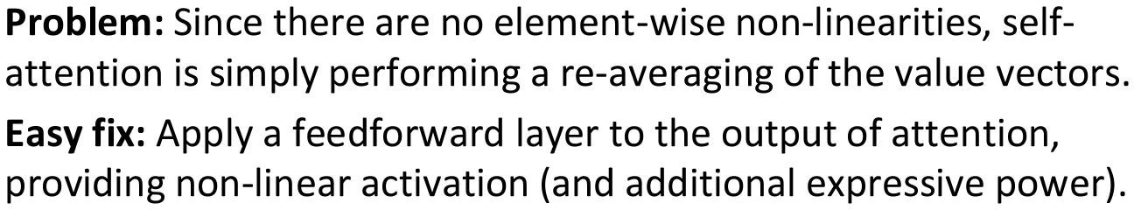
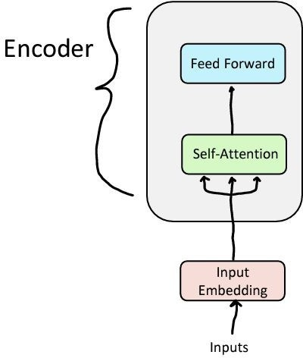
Feed-forward Layer

Slide 42
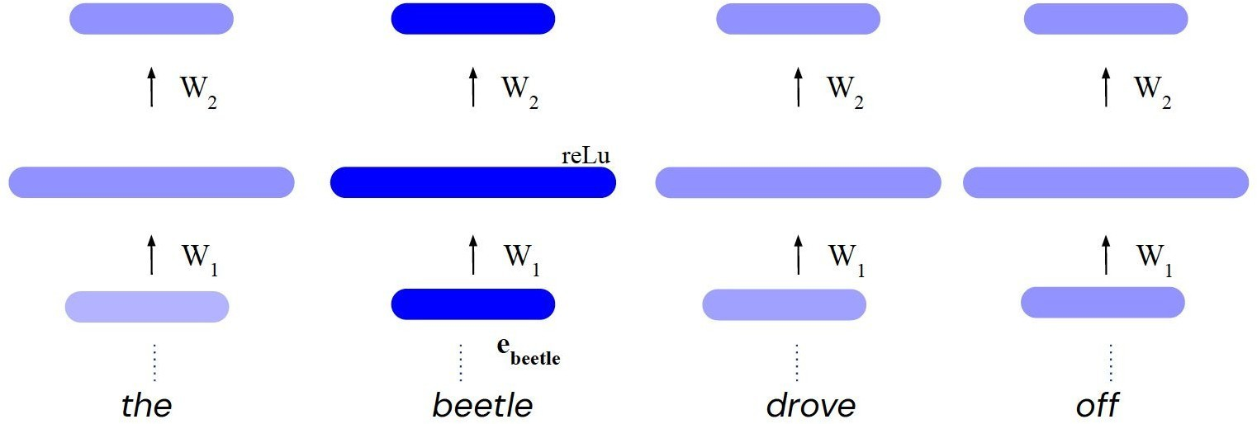
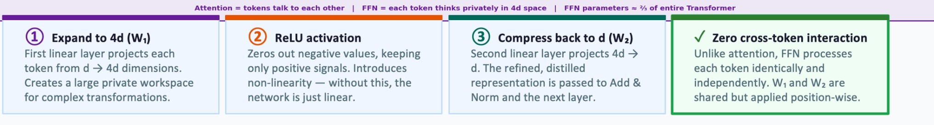
Feed-forward Layer
Source:
https://deepmind.com/learning-resources/deep-learning-lecture-series-2020

Slide 43
How to make this work for deep networks?
Repeat 6 times
Training Trick #1: Residual Connections Training Trick #2: LayerNorm
Training Trick #3: Scaled Dot Product Attention
https://web.stanford.edu/class/cs224n/

Slide 44
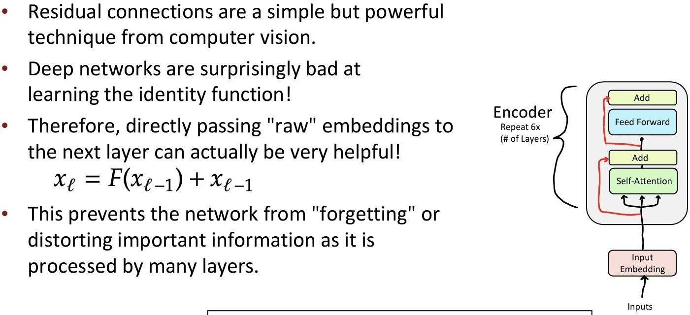
Training Trick #1: Residual Connections

Slide 45
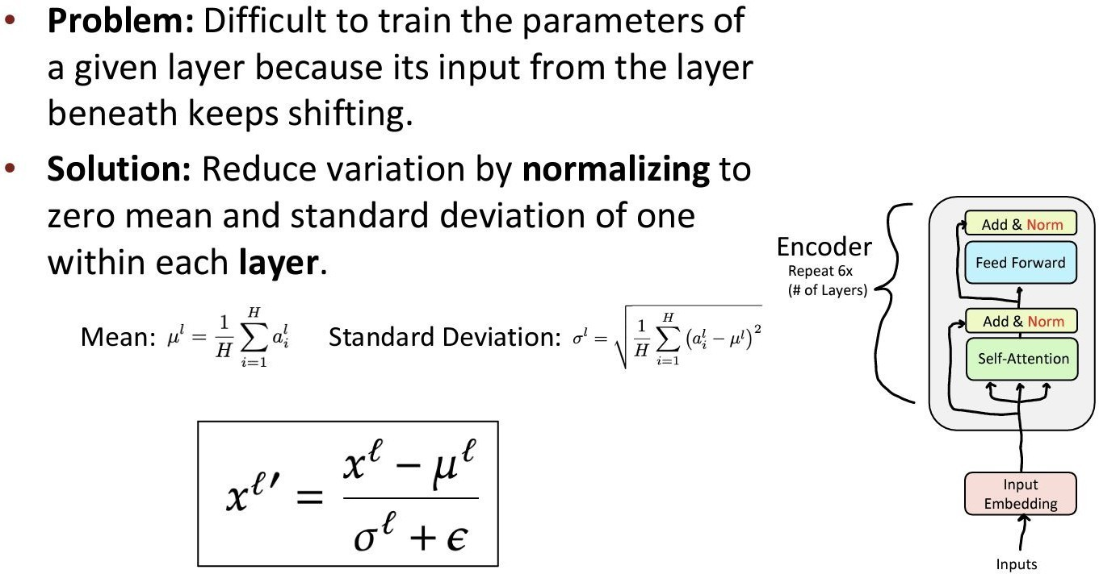
Training Trick #2: Layer Normalization
https://web.stanford.edu/class/cs224n/

Slide 46
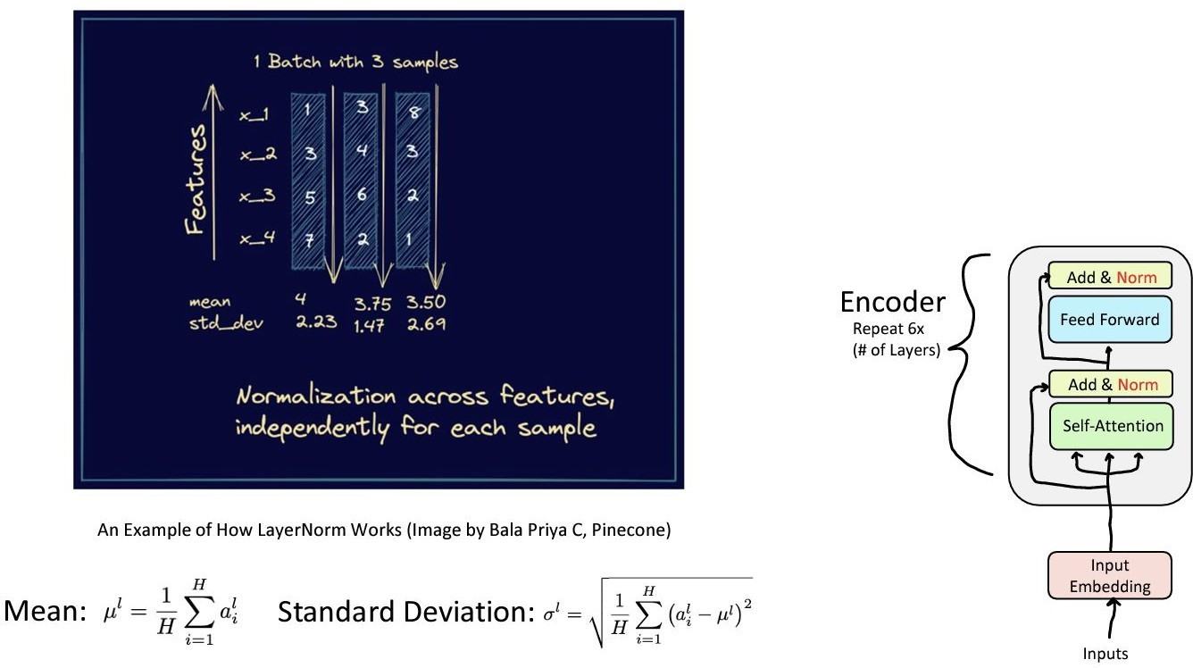
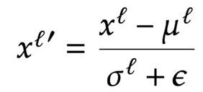
Training Trick #2: Layer Normalization
https://web.stanford.edu/class/cs224n/

Slide 47
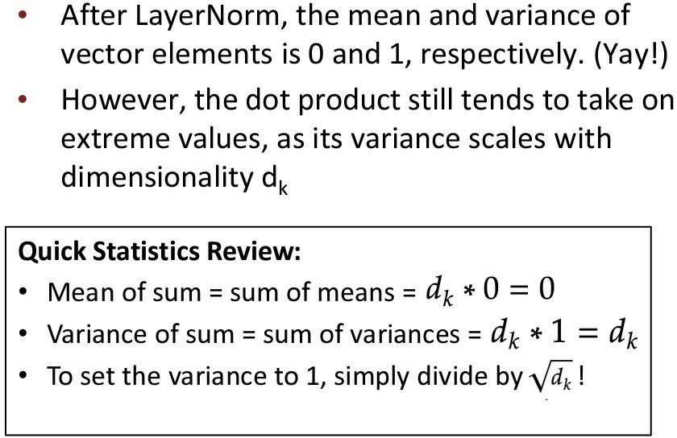
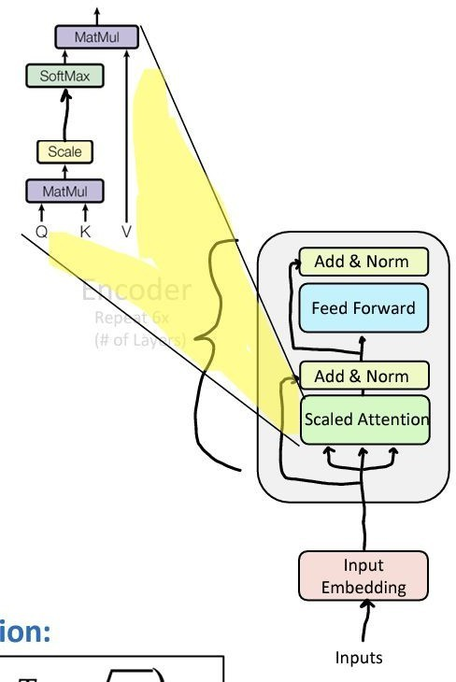
Training Trick #3: Scaled Dot Product Attention
https://web.stanford.edu/class/cs224n/

Slide 48
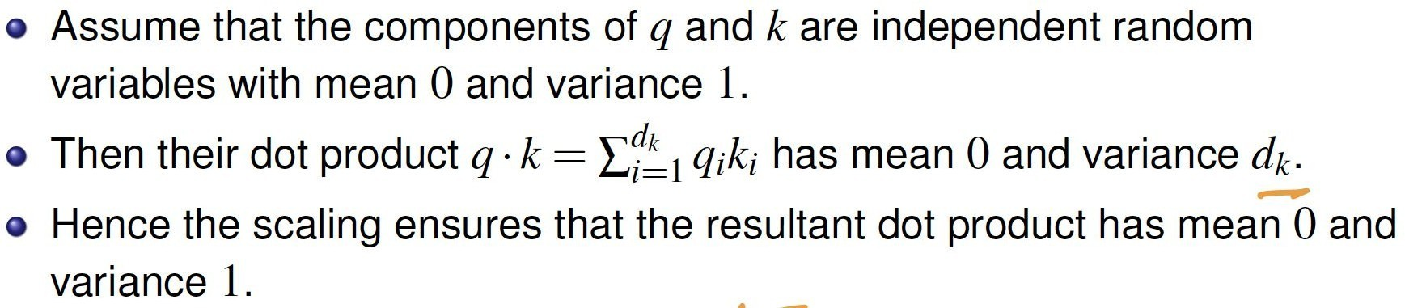
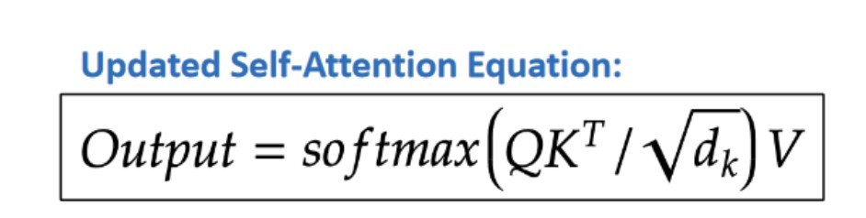
Training Trick #3: Scaled Dot Product Attention

Slide 49
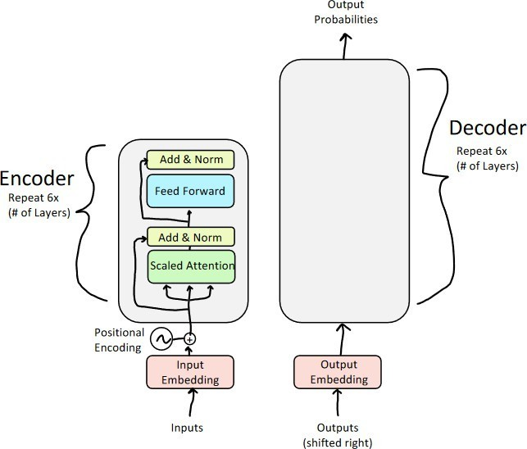
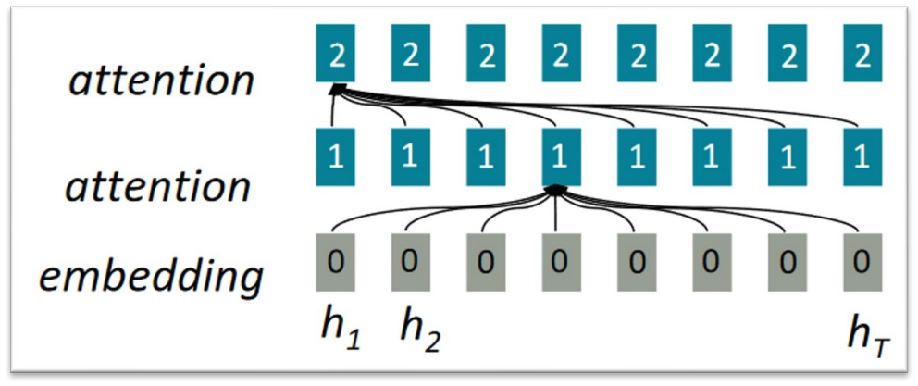
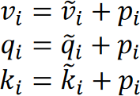
Positional Encoding
Sense of position is lost

Slide 50
Positional Encoding: Giving Every Word a Seat Number
Self-attention sees a set of words. Position must be added explicitly.
Same words, very different news Intuition for sinusoidal PE: a clock
"Kohli hit the ball" → a boundary
Second hand
fast
Minute hand
medium
Hour hand
slow
"The ball hit Kohli" → a physio visit
Each hand alone repeats, but together they give every moment a unique reading.
Sinusoidal PE works the same way: each pair of dimensions is a "hand" turning at its own frequency, so every position gets a unique fingerprint.
Without positions, self-attention gets the same bag of words
{Kohli, hit, the, ball} for both, and produces the same output for each word.
Fix: add a position vector pᵢ to each word embedding before attention.
PE(pos, 2i) = sin(pos / 10000^{2i/d}) · PE(pos, 2i+1) = cos(same)
Analogy: In a cinema hall everyone watches the same film (content), but your seat number (position) still decides whether you see the hero or a pillar.

Slide 51
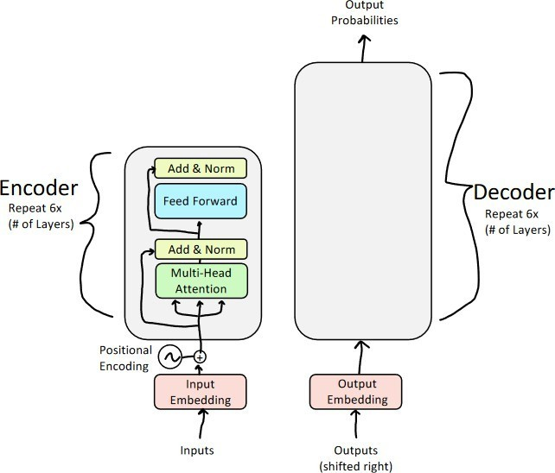
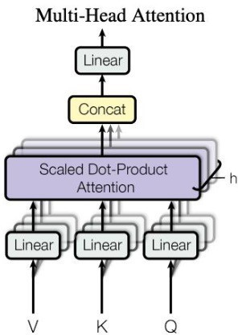
Multi-Head Attention

Slide 52

Why Multiple Heads?
One attention head captures one type of relationship. Language has many.
Single Attention Head
One Q,K,V → captures only one type of relationship
Multi-Head Attention
h independent heads → captures h different relationship types
*
Coreference
H1
Example: "it" → "animal"
Verb–Object
H2
Example: "cross" → "street"
Semantic sim.
^{H3} Example: "tired" → "animal"
Positional
H4
Example: nearby tokens
MultiHead(X) = Concat( head₁ … headₕ ) · Wᴼ headᵢ = softmax( QᵢKᵢᵀ / √dₖ ) Vᵢ

Slide 53


Multi-Head Attention: The Selection Committee
Same input, several experts, each asking a different question
Head 1
Batting coach
Head 2
Bowling coach
Chief selector = Wᴼ
Each head writes its own report. The reports are concatenated, then Wᴼ blends them into one decision.
Another real example: a hospital tumour board. Radiologist, pathologist, oncologist and surgeon study the same patient; each notices what the others miss.
Looks at: Technique, shot selection
Looks at: Pace, variations
≈ "it" → "animal" (who is who)
≈ "cross" → "street" (verb to object)
Head 3
Fitness trainer
Head 4
Captain
Looks at: Yo-Yo test, injuries
Looks at: Team fit, temperament
≈ "tired" → "animal" (meaning)
≈ nearby words (local order)
Why it matters: one head can only form one weighted average. Many heads let the model track grammar, meaning and position at the same time, in parallel, for almost the same cost (each head works in a smaller dₖ = d / h).

Slide 54

Where Transformers Run Today
The same building blocks you learned today, deployed at planetary scale
1
Chat assistants
2
Web search
3
Speech
ChatGPT, Gemini, Claude. GPT literally stands for Generative Pre-trained Transformer.
Google Search has used BERT (an encoder-only Transformer) to understand queries since 2019.
OpenAI Whisper, an encoder-decoder Transformer, powers transcription and auto-subtitles.
4
Biology
5
Indian languages
6
Medical imaging
AlphaFold 2 uses attention to predict protein structures; it shared the 2024 Nobel Prize in Chemistry.
AI4Bharat's IndicTrans2 translates across all 22 scheduled Indian languages, and supports the Bhashini mission.
Vision Transformers (ViT) cut an X-ray or a pathology slide into patches and treat them like words.
Takeaway: text, speech, proteins and pixels all become sequences of tokens. Attention does not care what the tokens are.

Slide 55
Five Things to Remember from Today
1 Order is information. Sequential data needs a model with memory.
One to take home
Why did the RNN fail its exam?
It studied the whole syllabus, but only remembered the last chapter.
The Transformer topped the class. It paid attention to everything, all at once.
2
RNNs remember through one hidden state hₜ, but gradients vanish or explode over long sequences.
3
LSTMs add gates and a cell state, stretching memory, yet still one vector and still sequential.
4
ELMo made embeddings contextual: "bank" (money) ≠ "bank" (river).
5
Attention lets every token look at every other token directly:
parallel, long-range, the engine of Transformers and today's LLMs.

Slide 56

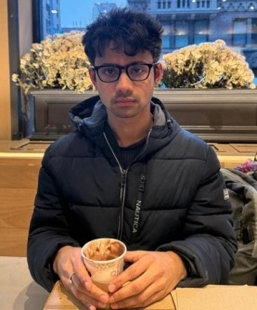

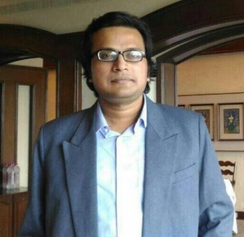
Thank you
Instructor
Teaching Assistants (IITKGP)
Sombit Bose
Anurup Naskar
Shrimon Mukherjee
Sabyasachi Mukhopadhyay

